Slide 1
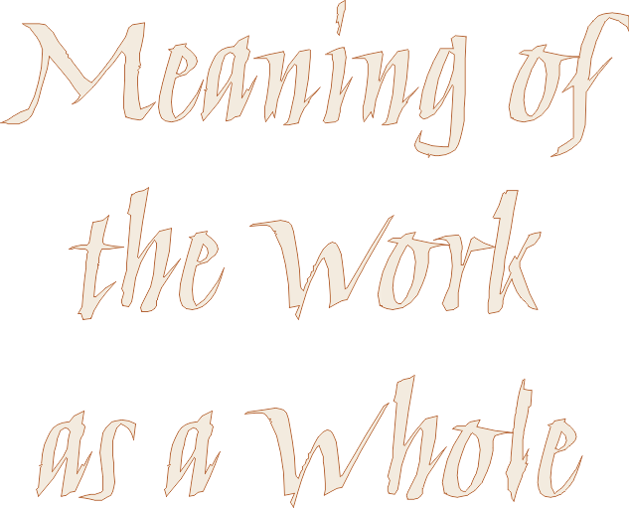
Meaning of the Work as a Whole

Slide 2
Tennessee Williams,
The Glass Menagerie
TOM:
Yes, I have tricks in my pocket, I have things up my sleeve.

Slide 3
Tennessee Williams
TOM:
Yes, I have tricks in my pocket, I have things up my sleeve.
But I am the opposite of a stage magician.
He gives you illusion that has the appearance of truth.
I give you truth in the pleasant disguise of illusion.

Slide 4
truth in the pleasant disguise of illusion
I give you truth in the pleasant disguise of illusion
the “meaning of the work as a whole”
the plot, the story
the setting
the characters & the narrator
the symbols....
artistically pleasing

Slide 5
Meaning of the Work as a Whole

